Slide 1
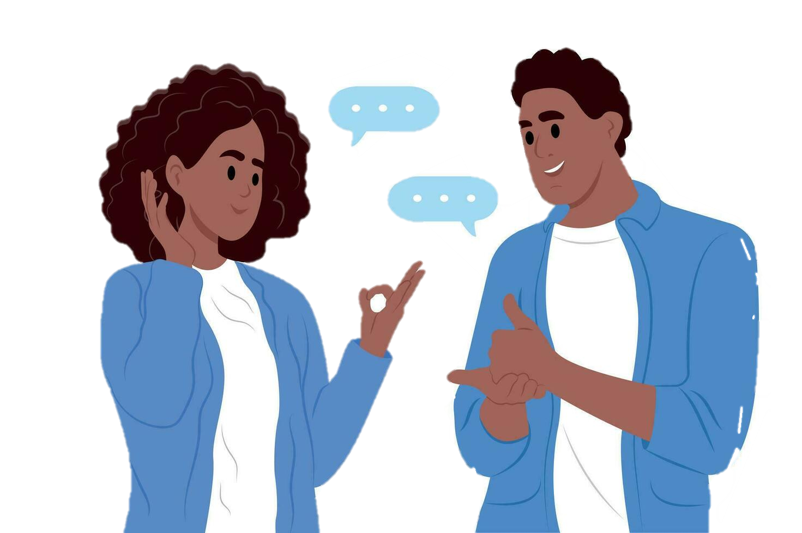
Sign2speak
Team name: tech titans college: velammal college of engineering and technology event name: paper palooza

Slide 2
Introduction
Sign2Speak is a website for mute and deaf people.
It changes signs into speech using a webcam.
Helps users communicate easily and build confidence.
Uses web and AI tools for real-time communication.
Users can upload slides and choose voice and language.

Slide 3
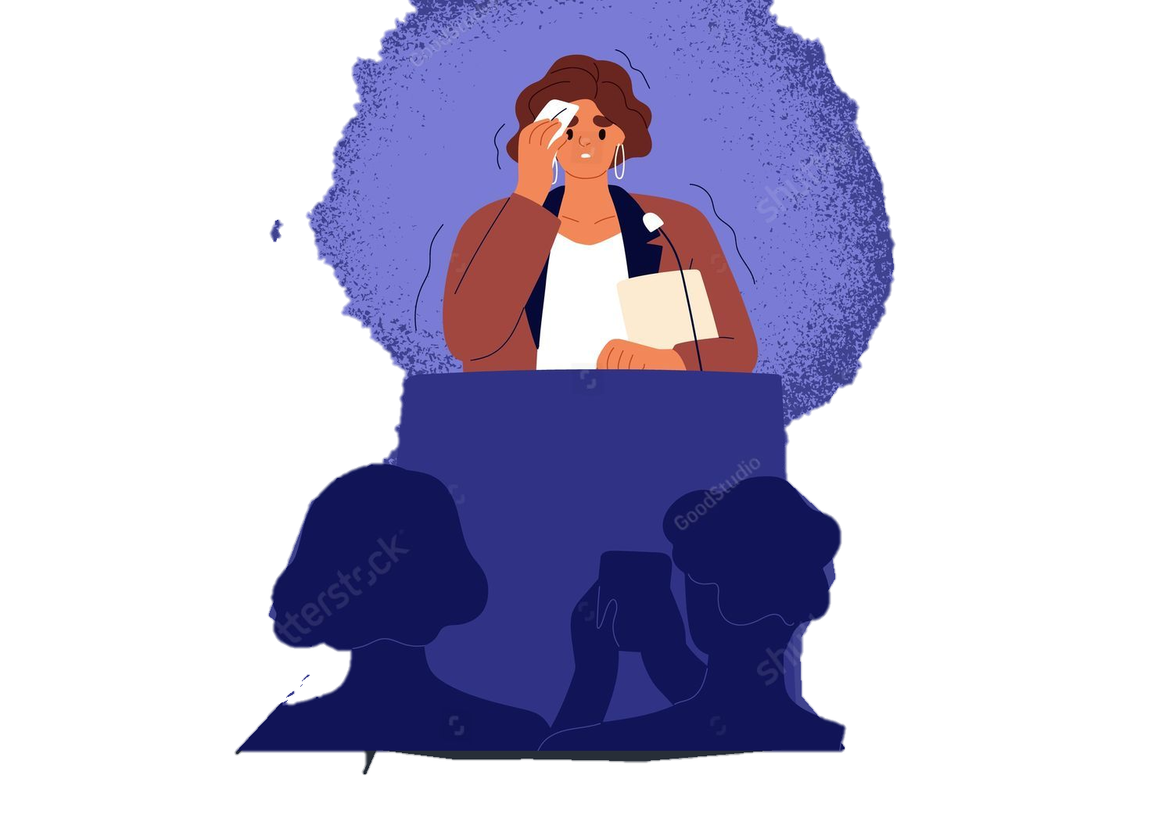
THE PROBLEM
Many people are unfamiliar with sign language.
Hearing-impaired individuals face communication challenges in public, education, and healthcare.
Existing tools are costly, hardware-dependent, or limited in scope.
Mute and deaf people struggle with presentations.

Slide 4
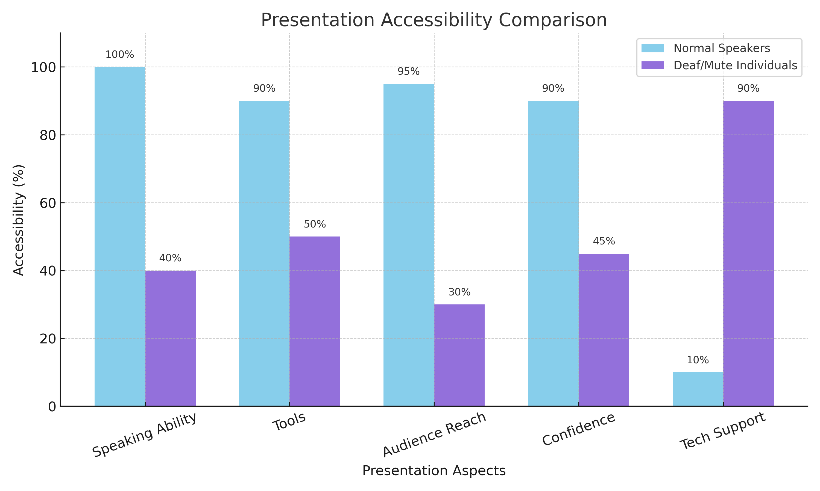
PRESENTATION ACCESIBILITY COMPARISON

Slide 5
Vision & mission
Create a web app that changes sign language to speech in real time.
Make communication simple, quick, and easy to use.
Add multi-language and slide presentation features in one tool.
Help users share ideas confidently in schools, offices, and public places.
Give mute and deaf users a digital voice.
Break communication barriers and make talks easy for everyone.

Slide 6
Concept over view
1.
2.
3.
4.
Sign2Speak is a web-based tool that helps mute and deaf users communicate easily.
It works on any device using a web browser, so no extra software is needed.
This process allows users to speak through sign language in real time.
The system is simple, fast, and accessible for presentations and communication.
5.
The system follows a simple 3-step process:
Gesture – User shows signs using the webcam.
Text – The system converts the gestures into text.
Speech – The text is then spoken out loud through voice output.

Slide 7
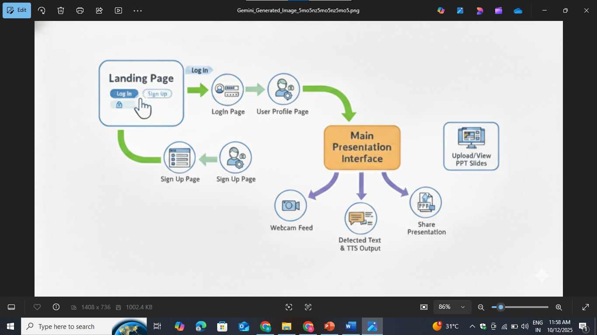
Work flow& interface design

Slide 8
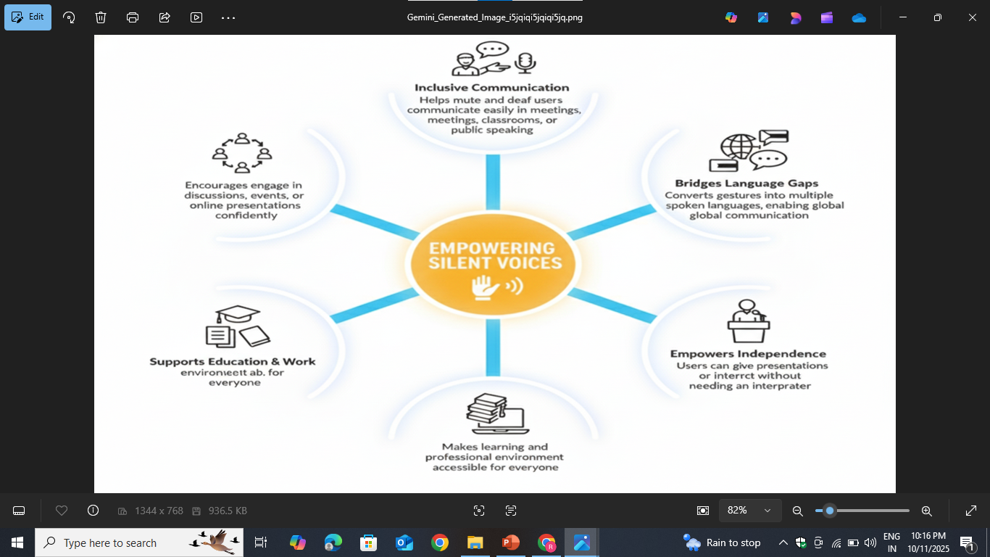
PROCESS FLOW

Slide 9
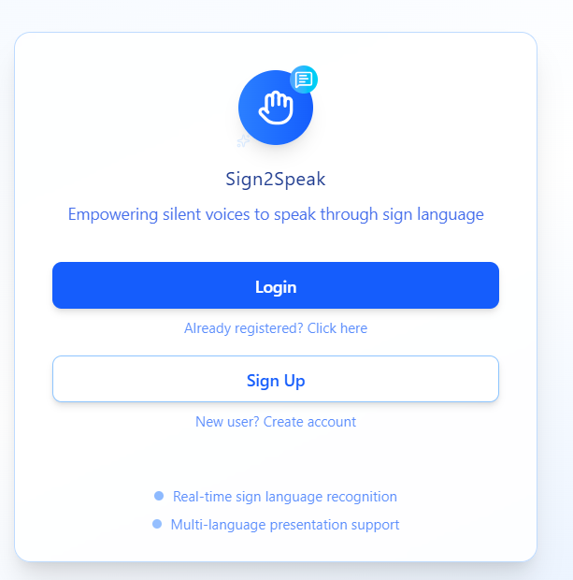
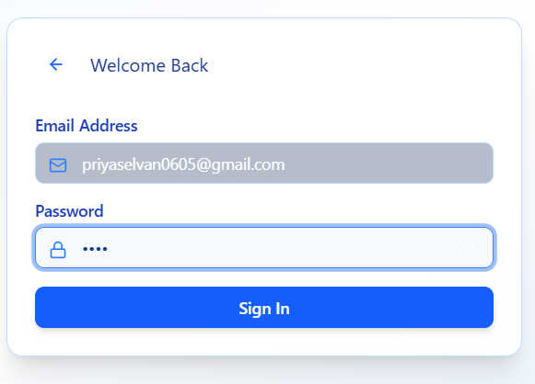
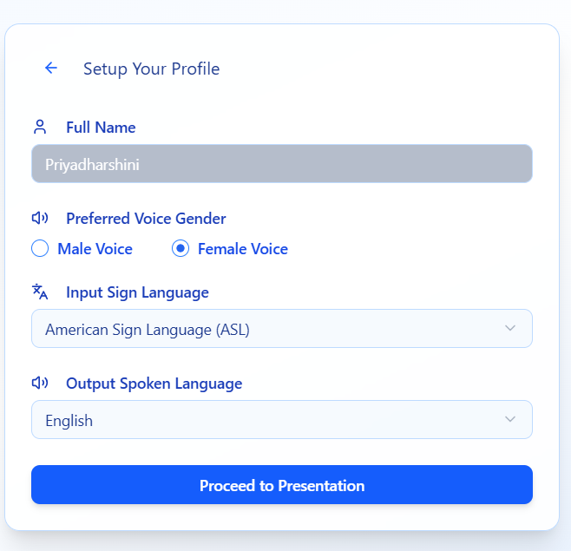
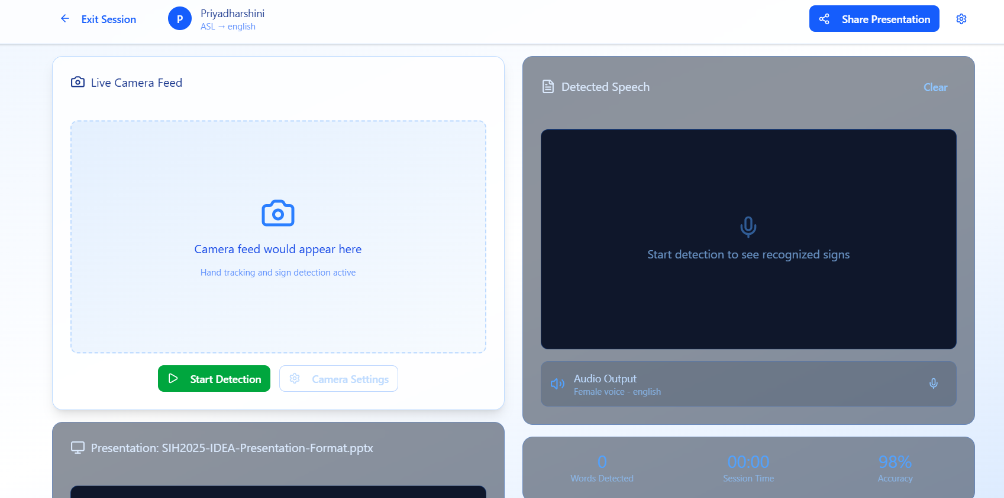
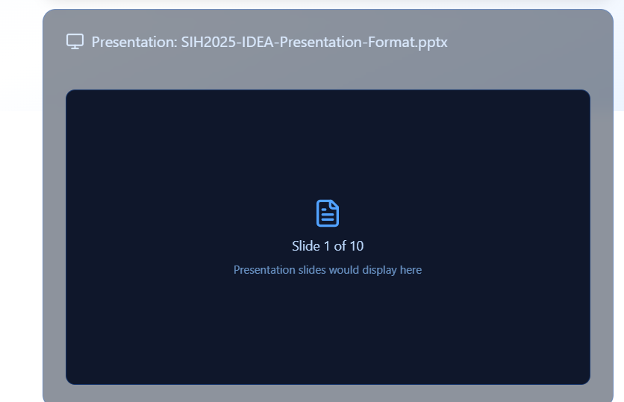
OUR WEBSITE FLOW

Slide 10
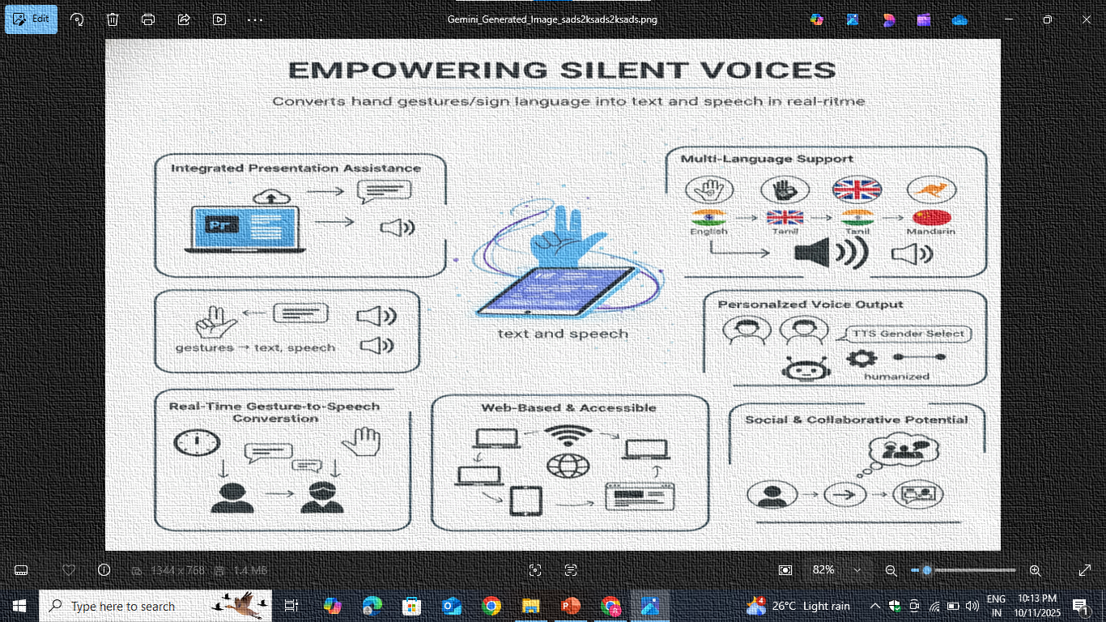
Innovation highlights

Slide 11
advantages
Helps mute and deaf people communicate effectively.
Works in real-time using a webcam.
Supports many languages and voice types.
Easy to use with no installation needed.
Integrates slide presentations in one place.
Encourages inclusive communication in education and workplaces.

Slide 12
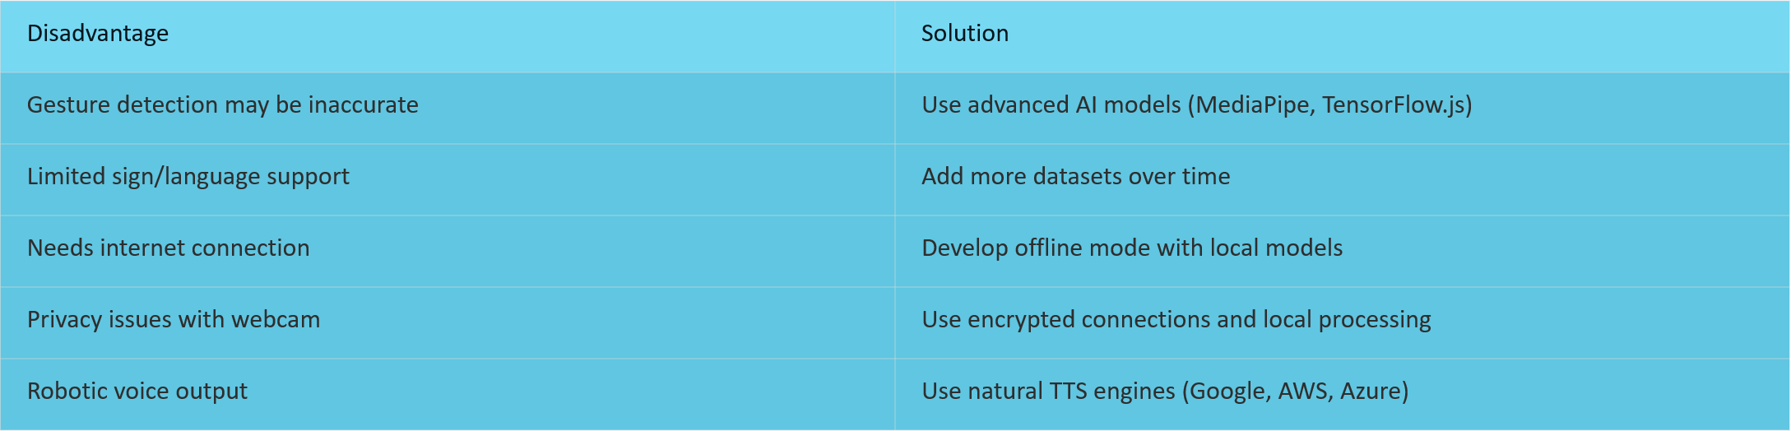
Disadvantages & how to overcome

Slide 13
conclusion
This website is a step towards inclusive and accessible tech.
It empowers the mute/deaf community to share their ideas confidently.
With future enhancements, it can become a universal communication tool.

Slide 14
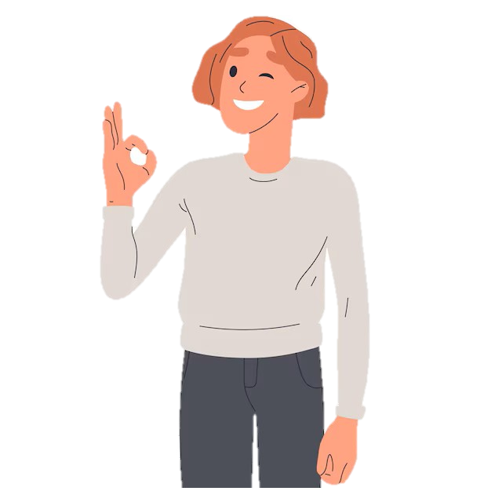
Further Improvisation Extending our website with ability of converting speech-to-sign

Slide 15
Thank you!
Do you have any questions? Contact: priyaselvan0605@gmail.com rajeshwarismdu@gmail.com

